Slide 1
Research Technology of 3D internet

Slide 2



GROUP MEMBERS
Đỗ Đức Nam
Huỳnh Thế Hiển
Mobile: 098860886 namdoduc.hcm@gmail.com FB: fb/doducnamm
Mobile: 0918.076.861 thehienvnag@gmail.com FB: fb/thehienvnag
Đồng Hữu Long
Mobile: 0931192303 donglong@gmail.com FB: fb/tranthaiduc

Slide 3
TABLE OF CONTENTS
01
02
03
04
3D internet
vs.
nowadays internet
3D Internet components
Required Infrastructure and Technology
Applications

Slide 4
01.
3D Internet
vs.
Nowadays Internet

Slide 5
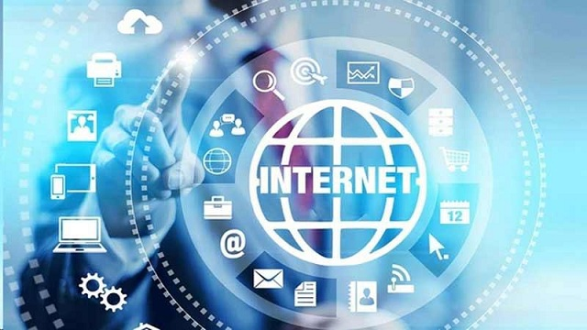
What is Internet ?

Slide 6
What is Internet ?
The Internet is a globally accessible information system that is publicly accessible and consists of interconnected computer networks.
This system transmits information in the form of packet switching

Slide 7


Slide 8
What is Internet 3D ?
Like existing internet, 3D Internets an interactive virtual environment for services, interaction and communication.
3D Internet are combination of two powerful forces:
• The internet
• 3D graphics

Slide 9

Internet 3D Challenges

Slide 10
• Slow computers connections
• Downloading 3D content took a long time.
• Once downloaded, it ran very slowly.
• Quality of the graphics was poor.

Slide 11
02.
3D Internet components

Slide 12
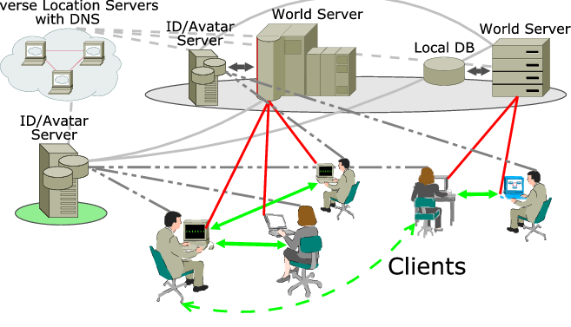

Slide 13
World Server
Provide user- or server-side created, static and dynamic content making up the specific webplace (3D environment).
Contents includes visuals, physics engine, avatar data, media, and more to client programs.

Slide 14
Avatar/ID Servers:
Virtual identity management systems:
Contain identity and avatar information as well as inventory of registered user.
Also ensure privacy and security of stored information.

Slide 15
Universal location servers:
Virtual location management systems:
Provide virtual geographical information.
Also act as a distributed directory of the world, avatar servers and users.

Slide 16
Clients:
Browser-like viewer programs running on user’s computers with extensive networking, caching, and 3D rendering capabilities.

Slide 17
03.
Required Infrastructure and Technology

Slide 18
Speed:
Internet speed is one of the most significant implications that are being faced by the 3D Internet.

Slide 19
Hardware:
Great difficulty in displaying 3D Object with 2D Devices nature.
Moreover rendering of such high end 3D models requires high usage of RAM and GPU.

Slide 20
Cost:
The two above concludes that the cost involved in the overall implementation is high, which may discourage the popularity of 3D internet.

Slide 21
VRML technology:
VRML is the Virtual Reality Modelling Language, a system for describing 3D scenes on the Web.
Using text files in a similar format to the HTML, VRML allows a browser to produce the illusion of a three dimensional environment.

Slide 22
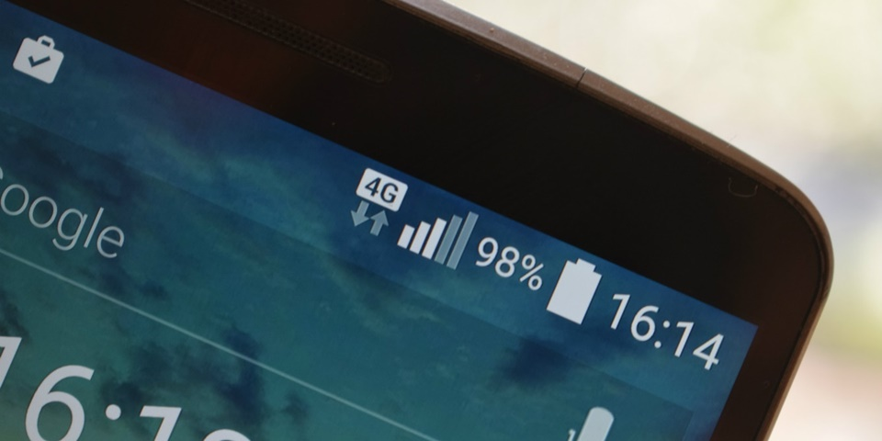
3D Internet can be implemented:
The popularity of 3G, 4G and 5G mobile network allows the most convenient ways of transferring 3D contents between clients.

Slide 23
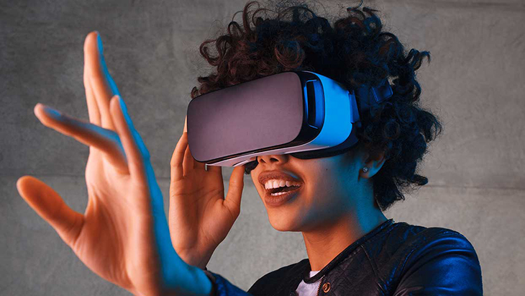
3D Internet can be implemented:
Great innovation in Virtual Reality technology (VR).

Slide 24
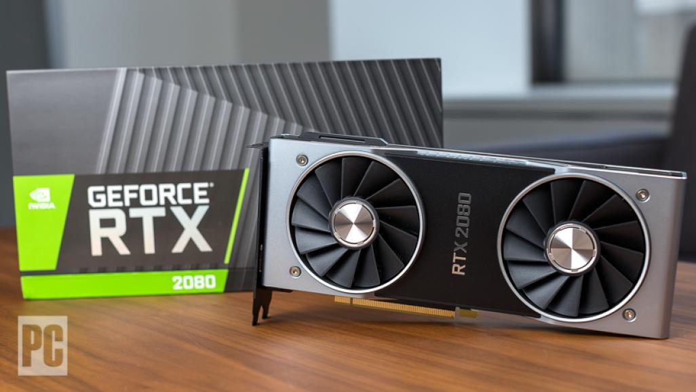
3D Internet can be implemented:
CPU and GPU witnessed an increase in speed and power on the contrary of a decrease in cost.

Slide 25
3D advantages:
Participants experience virtual world.
Participant have control over entire virtual space .
Participants can choose to engage with an offering.
Better understanding of concepts.
Replicates real life.
Efficiency

Slide 26
04.
Applications of 3D Internet

Slide 27
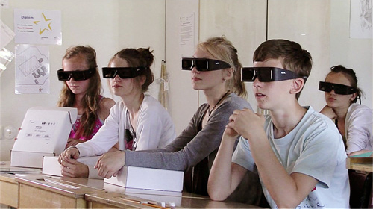
Education:
3D Internet can be used as a platform for education by many institutions, such as colleges, universities, libraries and government entities.

Slide 28

Religion:
Religious organizations can make use of the 3D Internet to open virtual meeting places within specified locations.

Slide 29
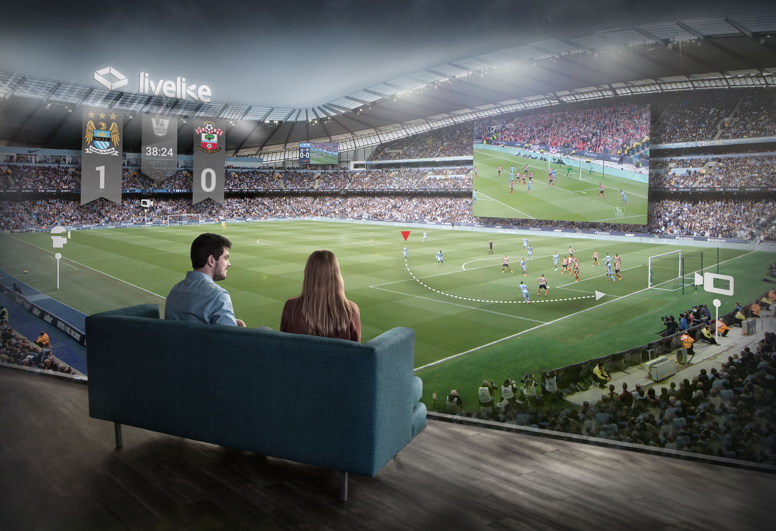
Live Sport Entertainment:
Popular forms of live entertainment could also be placed into the 3D Internet.

Slide 30
Embassies:
We could create embassies in 3D Internet, where visitors will be able to talk face-to-face with a computer-generated ambassador about visas, trade and other issues.

Slide 31
Arts:
The modeling in 3D Internet would allow the artists to create new forms of art.

Slide 32
RESOURCES
International Journal of Current Research and Modern Education (IJCRME)
Journal of Information Technology & Software Engineering - Research Article 3D Internet

Slide 33

THANK YOU FOR YOUR LISTENING
Please feel free to ask

